Slide 1
PROJECT: TABLEAU DATA ANALYSIS: SALES_INSIGHTS
“A Picture Is Worth Thousand Words.”
Step 1 : Problem Statement
Step 2 : Data Discovery
Step 3 : Data Analysis Using SQL
Step 4 : Data Cleaning & ETL in Tableau
Step 5 : Build tableau Dashboard
Step 6 : Feedback From Stockholder & Profit Analysis
COMPANY : AtliQ TECHNOLOGIES

Slide 2

Step 1 : Problem Statement

Slide 3
Problem Statement:
Revenue Breakdown by Cities?
Revenue Breakdown by Year & months?
Top 5 Customer by Revenue & sales Quantity?
Top 5 product by Revenue Number?
Visualization better than Spreadsheets!

Slide 4
Step 2 : Data Discovery

Slide 5
Purpose
Stakeholders
End Result
Success criteria
AIMS GRID
Analytics and Informatics Management Systems.

Slide 6
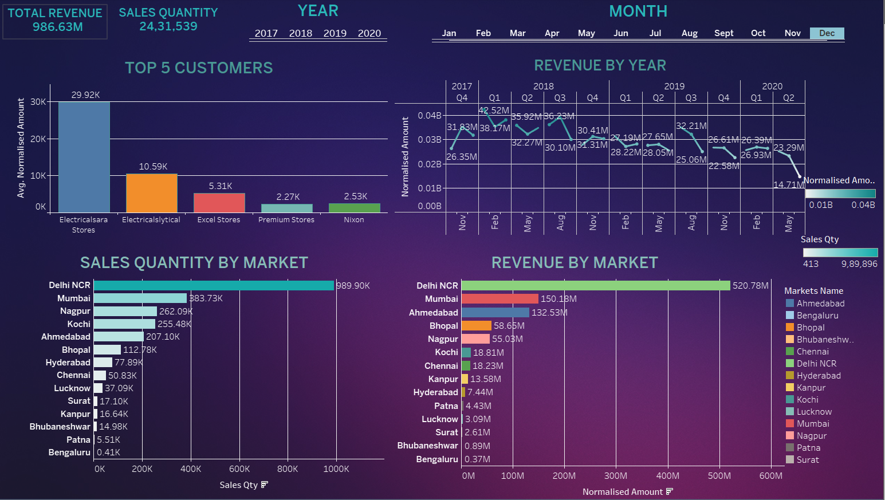



SALES MGMT SYESTEM
OLTP – Online Transaction Processing
SQL Shell +
Workbench +
Server Download Steps
https://youtu.be/hbNRULz6GFA?si=9LR644eQ1Mv6VqdM

Slide 7
Step 3 : Data Analysis Using SQL

Slide 8
DATA ANALYSIS USING SQL
1. Show all customer records
SELECT * FROM customers;
2. Show total number of customers
SELECT count(*) FROM customers;
3. Show transactions for Chennai market (market code for chennai is Mark001
SELECT * FROM transactions where market_code='Mark001';
4. Show distrinct product codes that were sold in chennai
SELECT distinct product_code FROM transactions where market_code='Mark001';
5. Show transactions where currency is US dollars
SELECT * from transactions where currency="USD"
6. Show transactions in 2020 join by date table
SELECT transactions.*, date.* FROM transactions INNER JOIN date ON transactions.order_date=date.date where date.year=2020;
7. Show total revenue in year 2020,
SELECT SUM(transactions.sales_amount) FROM transactions INNER JOIN date ON transactions.order_date=date.date where date.year=2020 and transactions.currency="INR\r" or transactions.currency="USD\r";
8. Show total revenue in year 2020, January Month,
SELECT SUM(transactions.sales_amount) FROM transactions INNER JOIN date ON transactions.order_date=date.date where date.year=2020 and and date.month_name="January" and (transactions.currency="INR\r" or transactions.currency="USD\r");
9. Show total revenue in year 2020 in Chennai
SELECT SUM(transactions.sales_amount) FROM transactions INNER JOIN date ON transactions.order_date=date.date where date.year=2020 and transactions.market_code="Mark001";

Slide 9
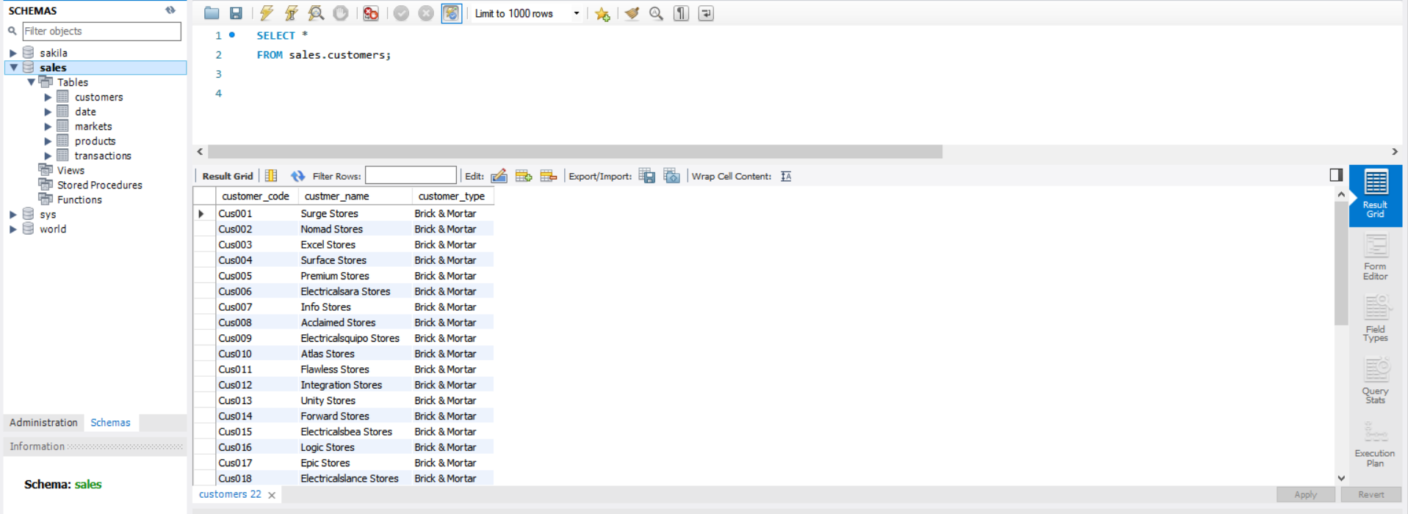

Slide 10
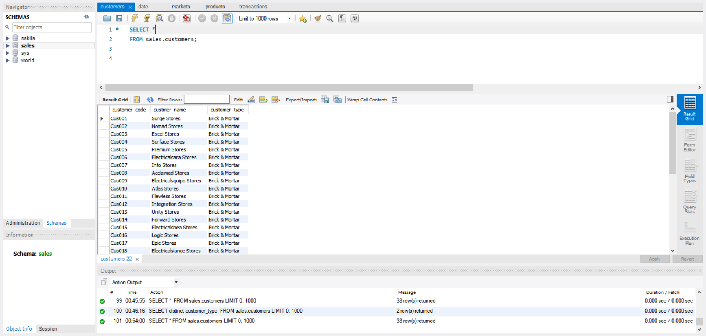

Slide 11
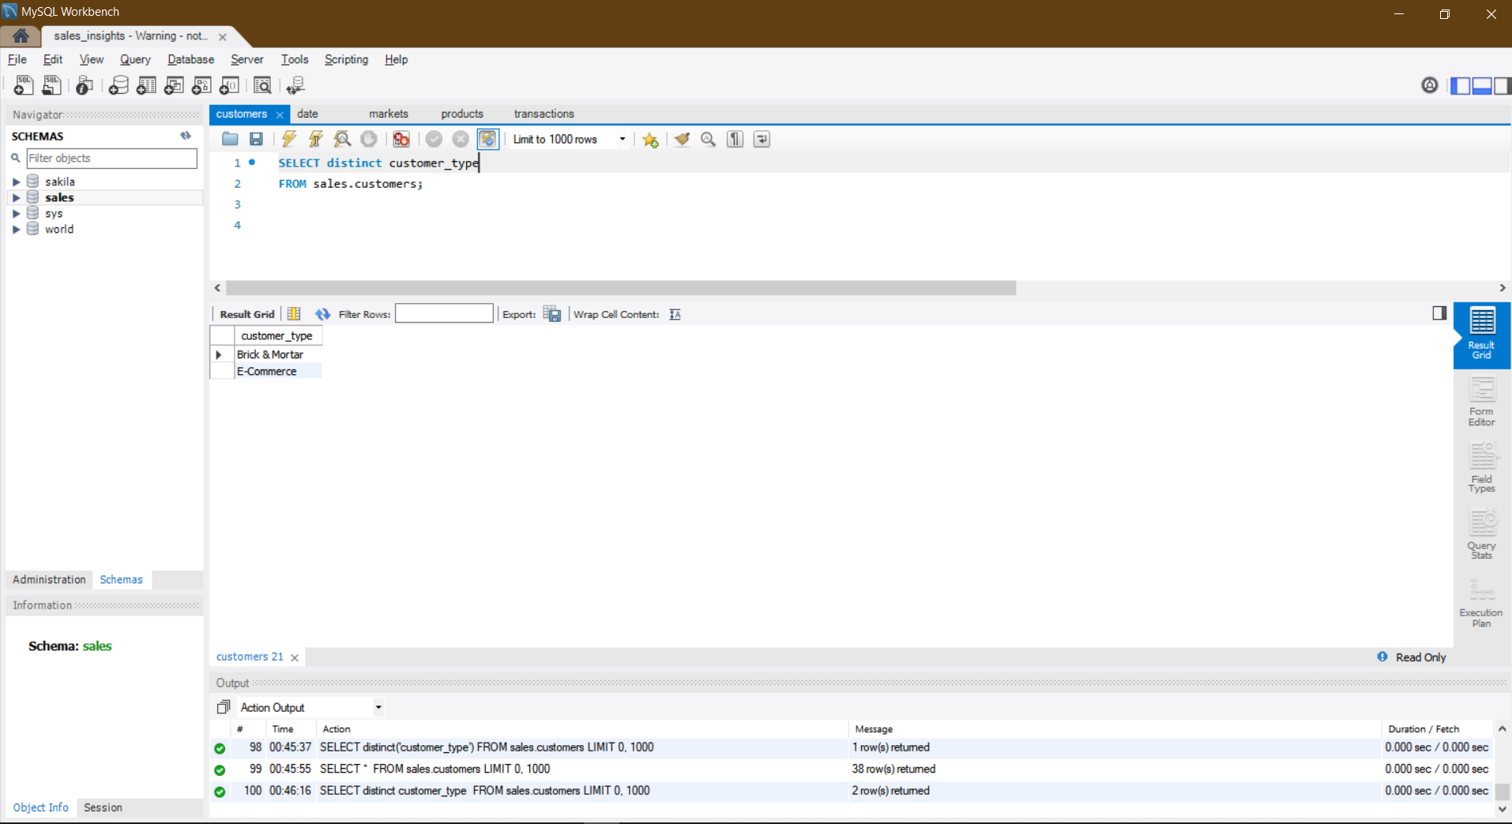

Slide 12
Step 4 : Data Cleaning & ETL in Tableau

Slide 13
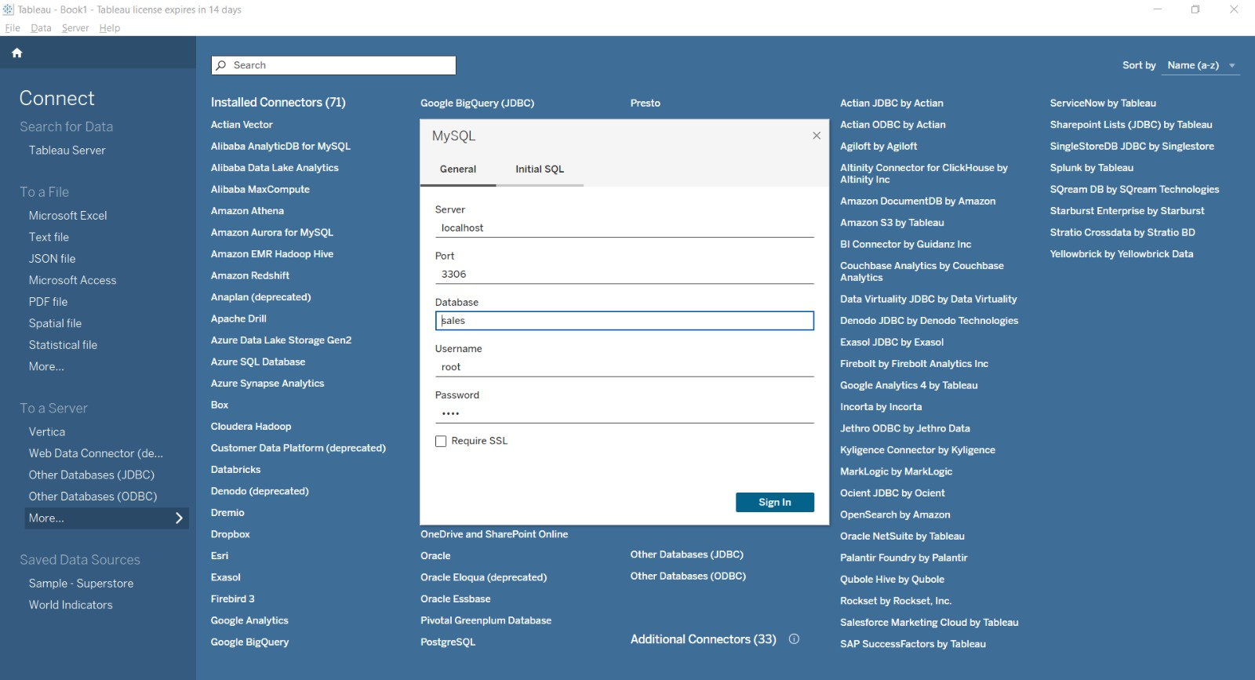

Slide 14
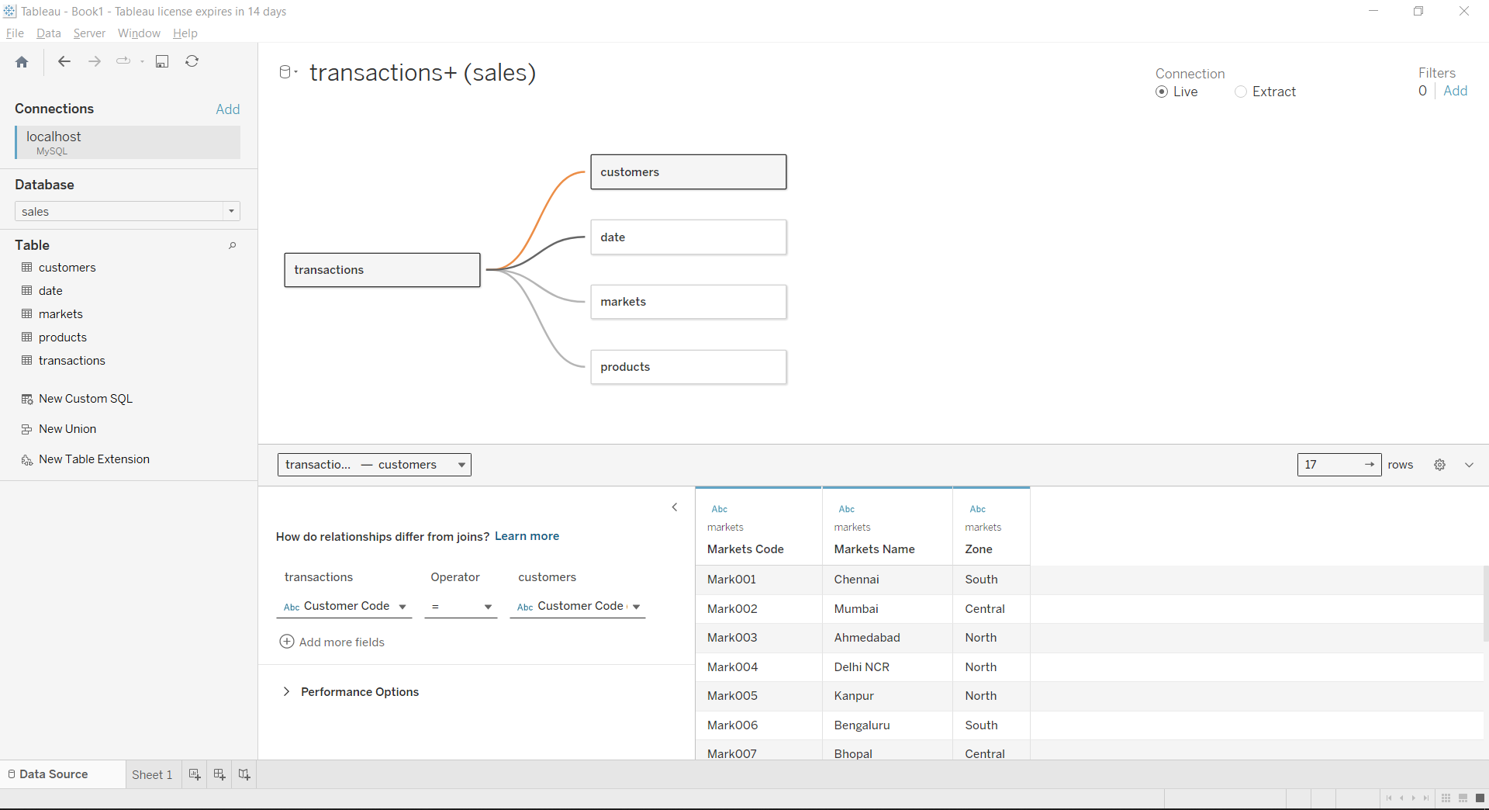
STAR SCHEMA
multi-dimensional data model used to organize data in a database
so that it is easy to understand and analyze.

Slide 15
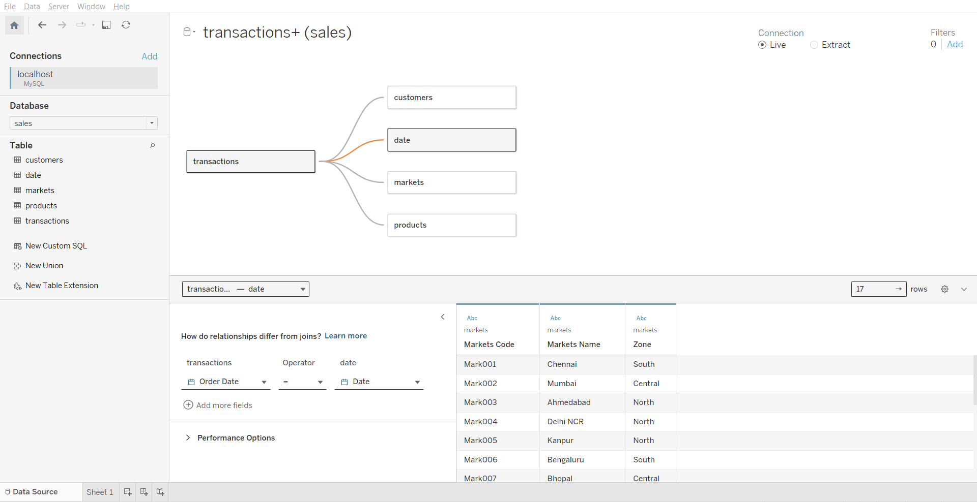

Slide 16
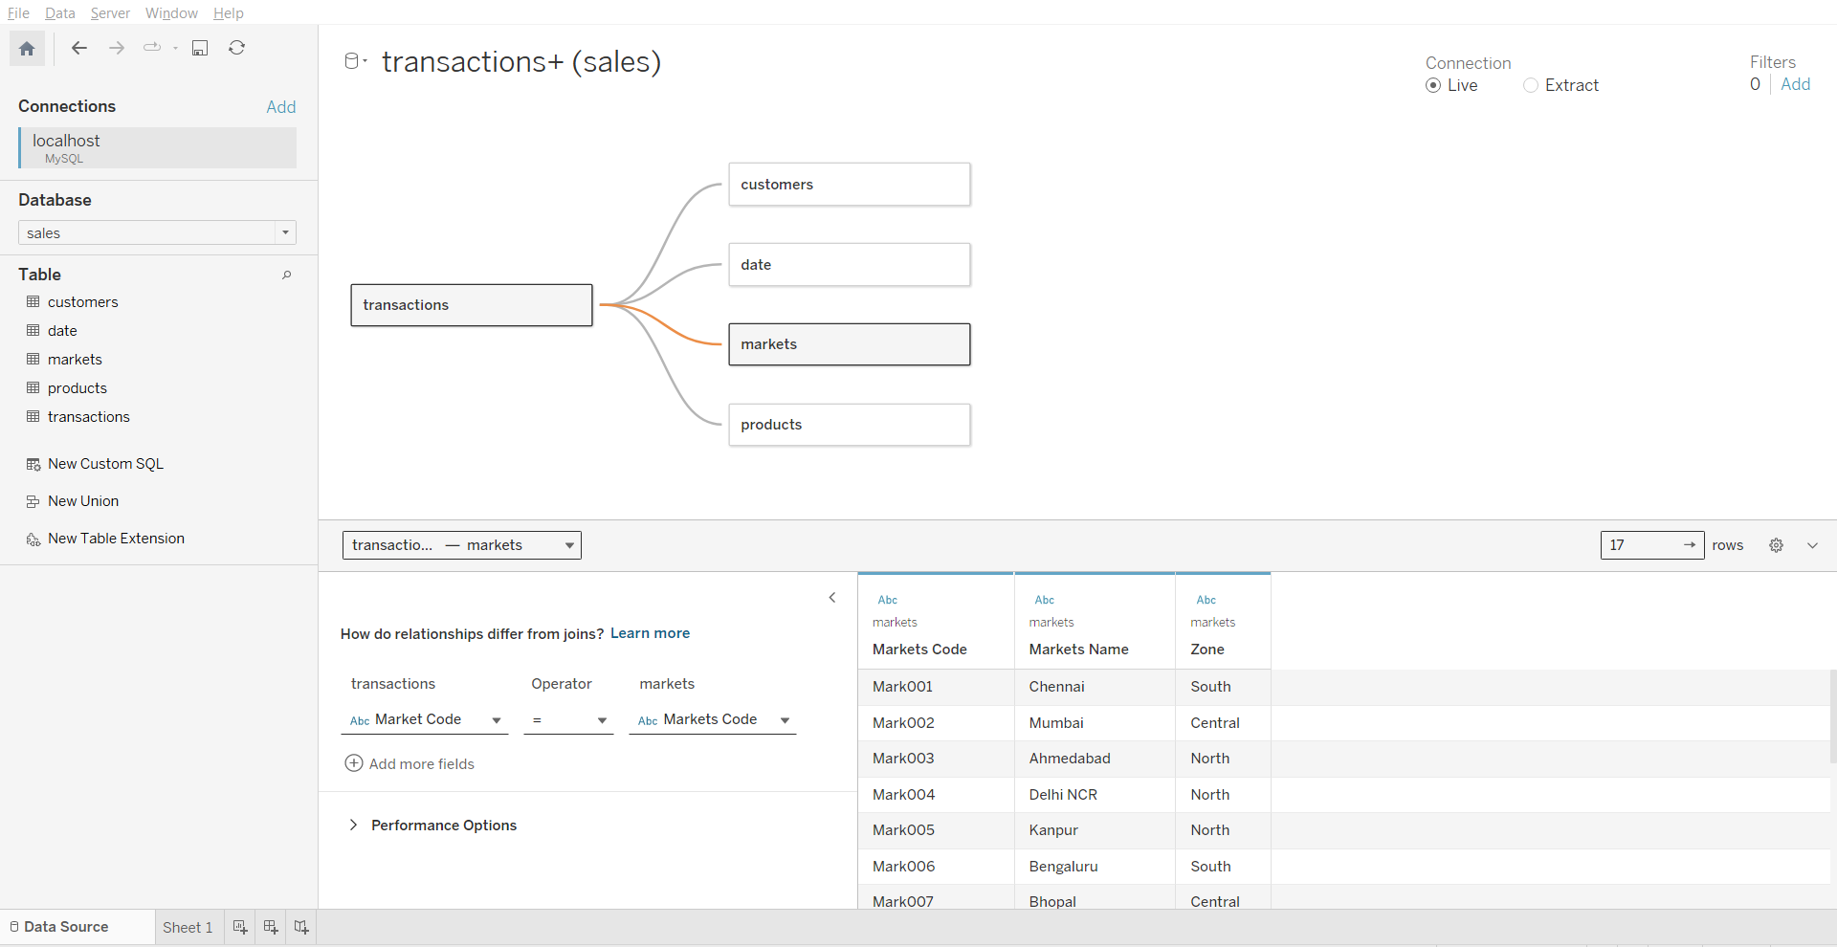

Slide 17
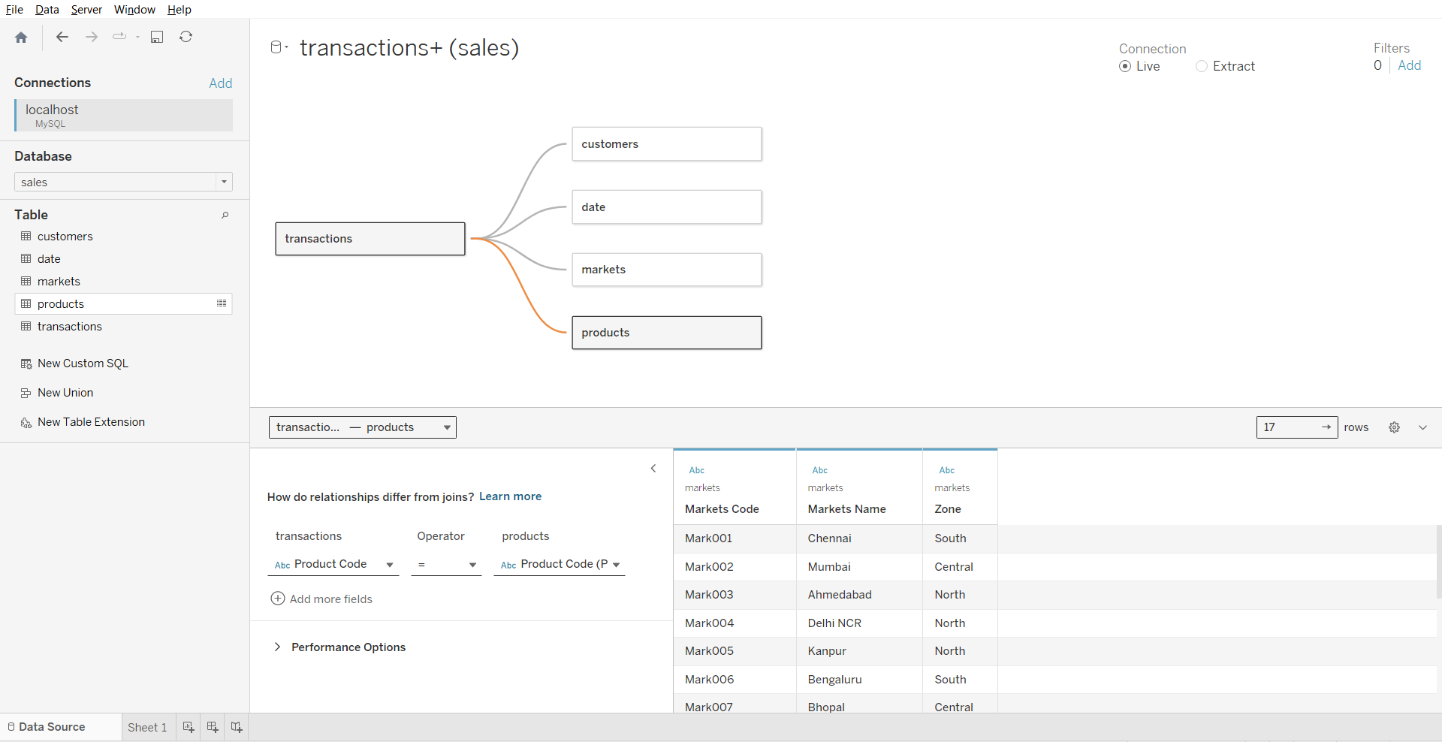

Slide 18
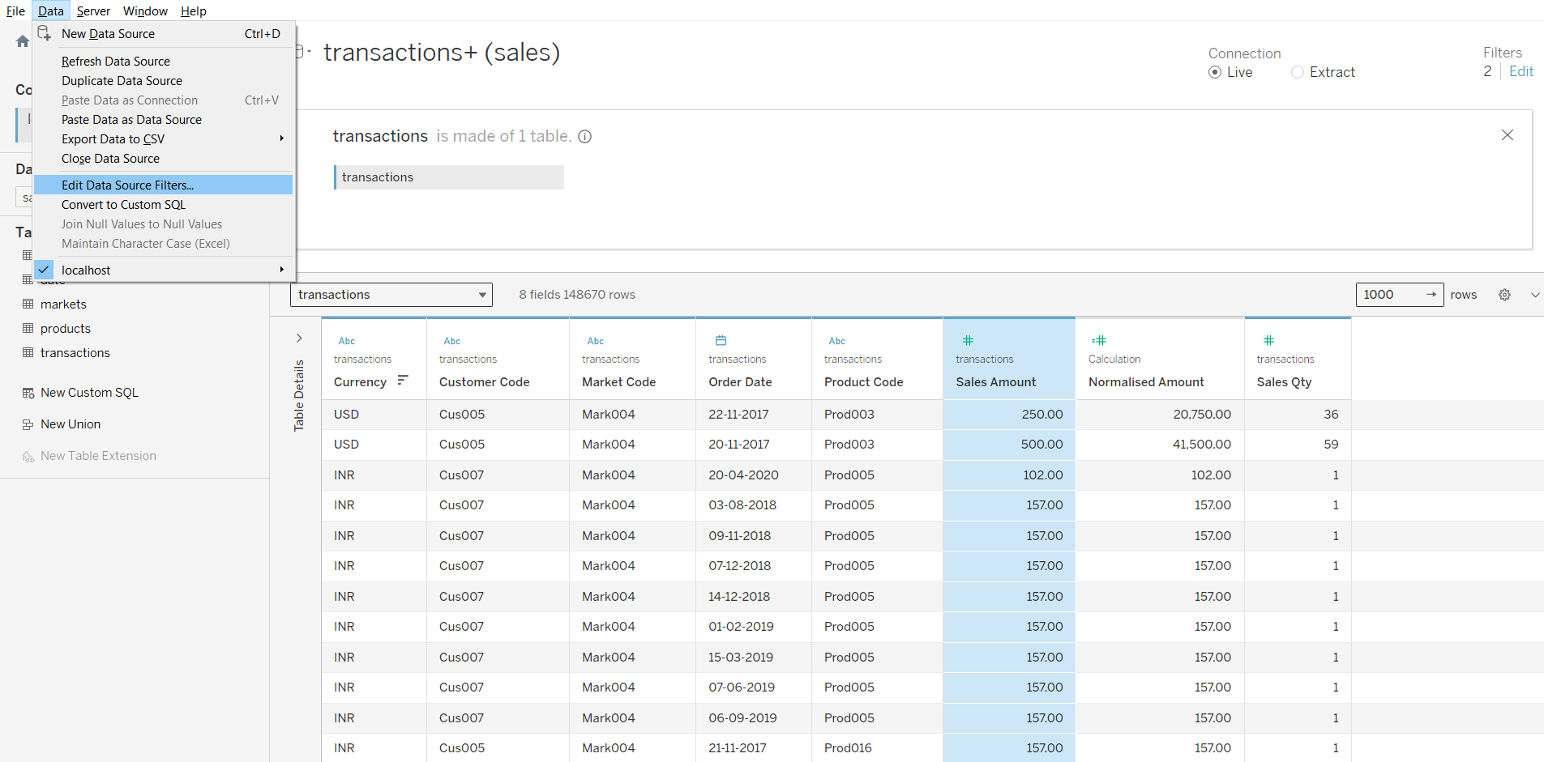

Slide 19
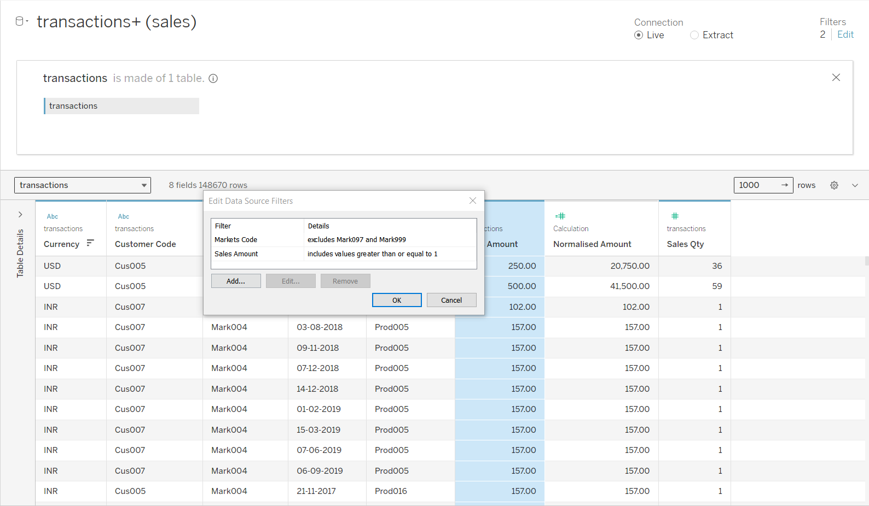

Slide 20
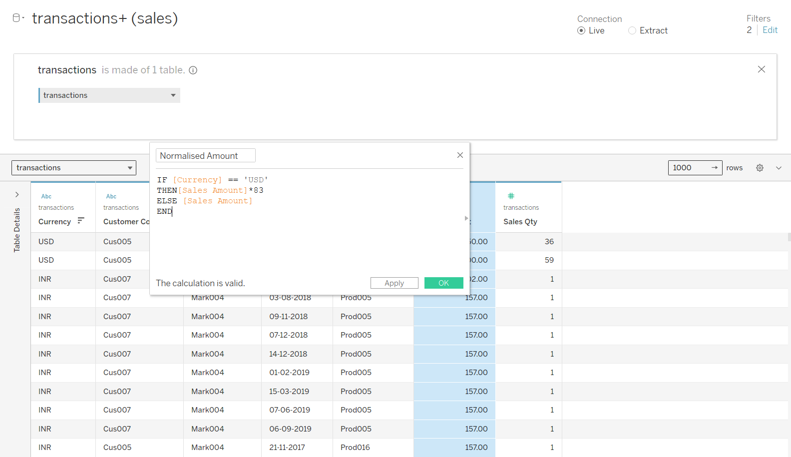

Slide 21
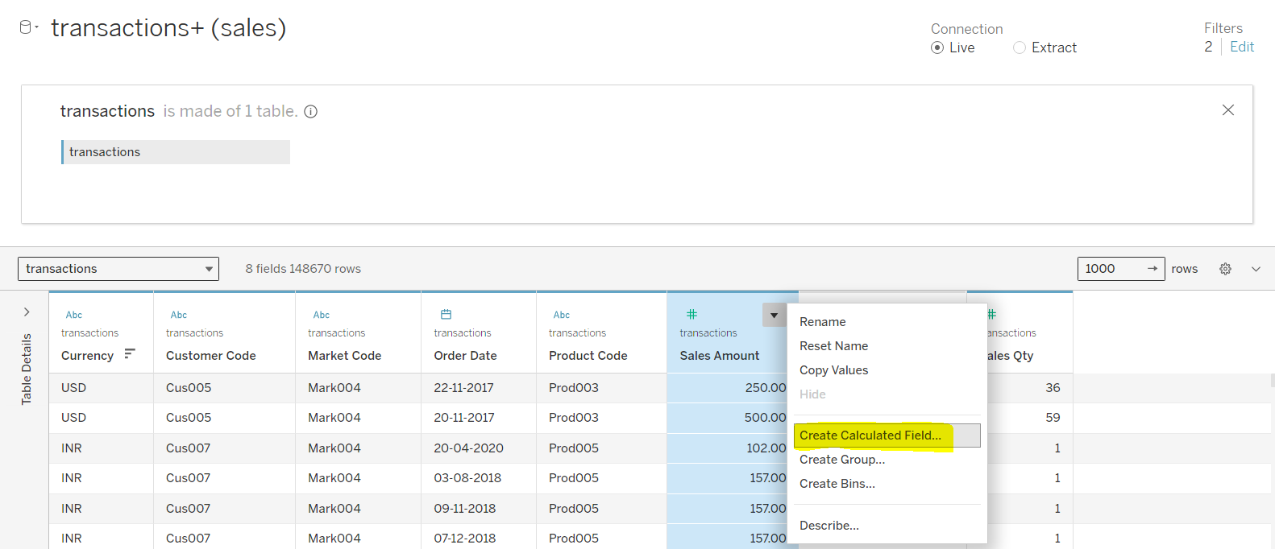

Slide 22
Step 5 : Build tableau Dashboard

Slide 23
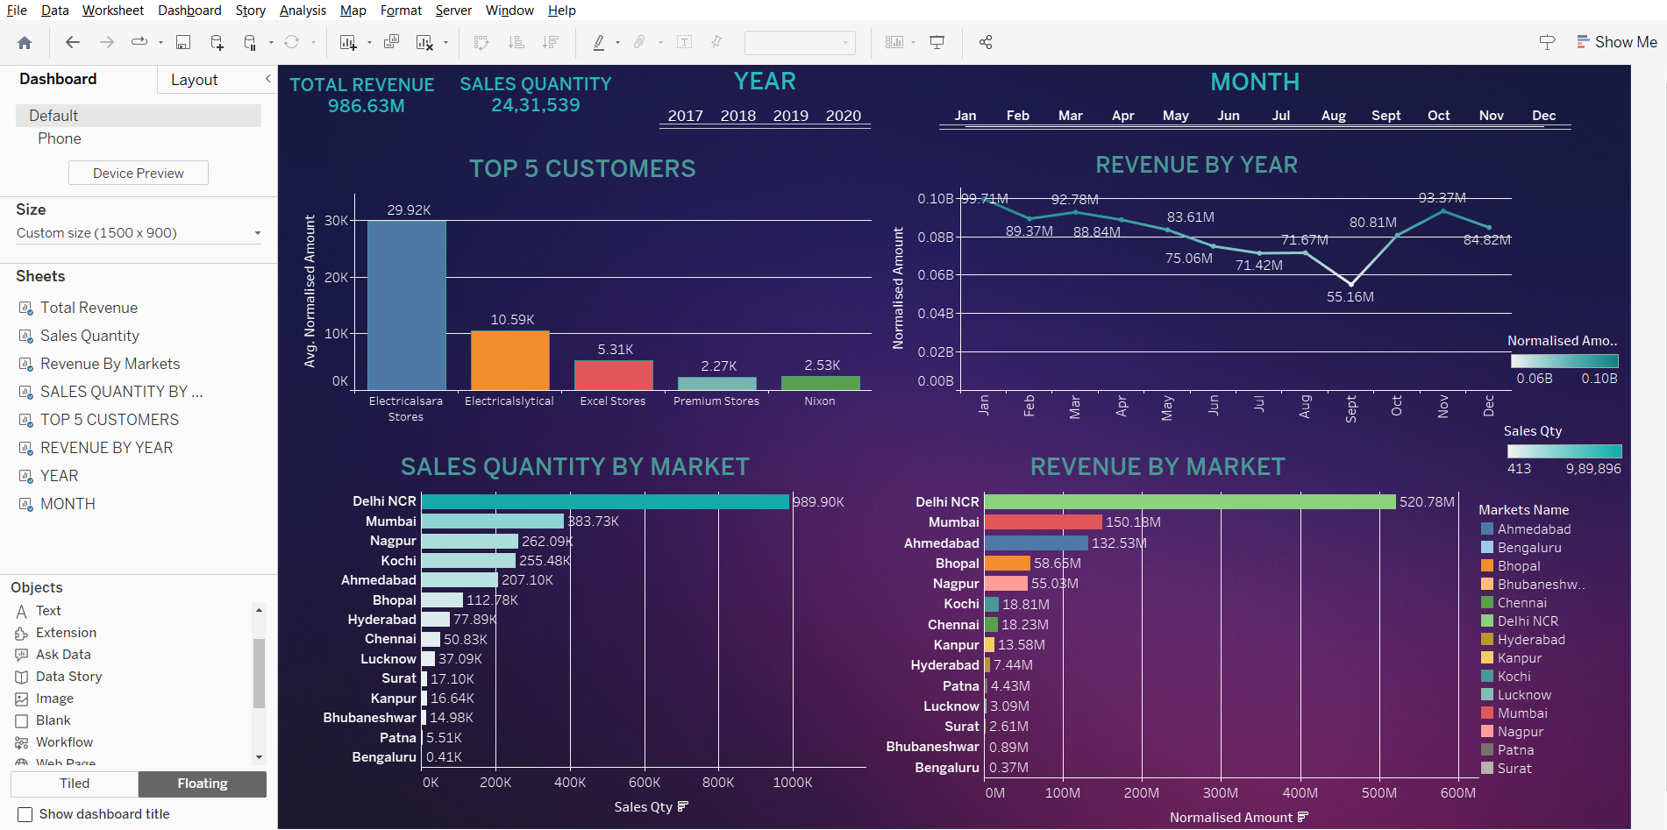

Slide 24
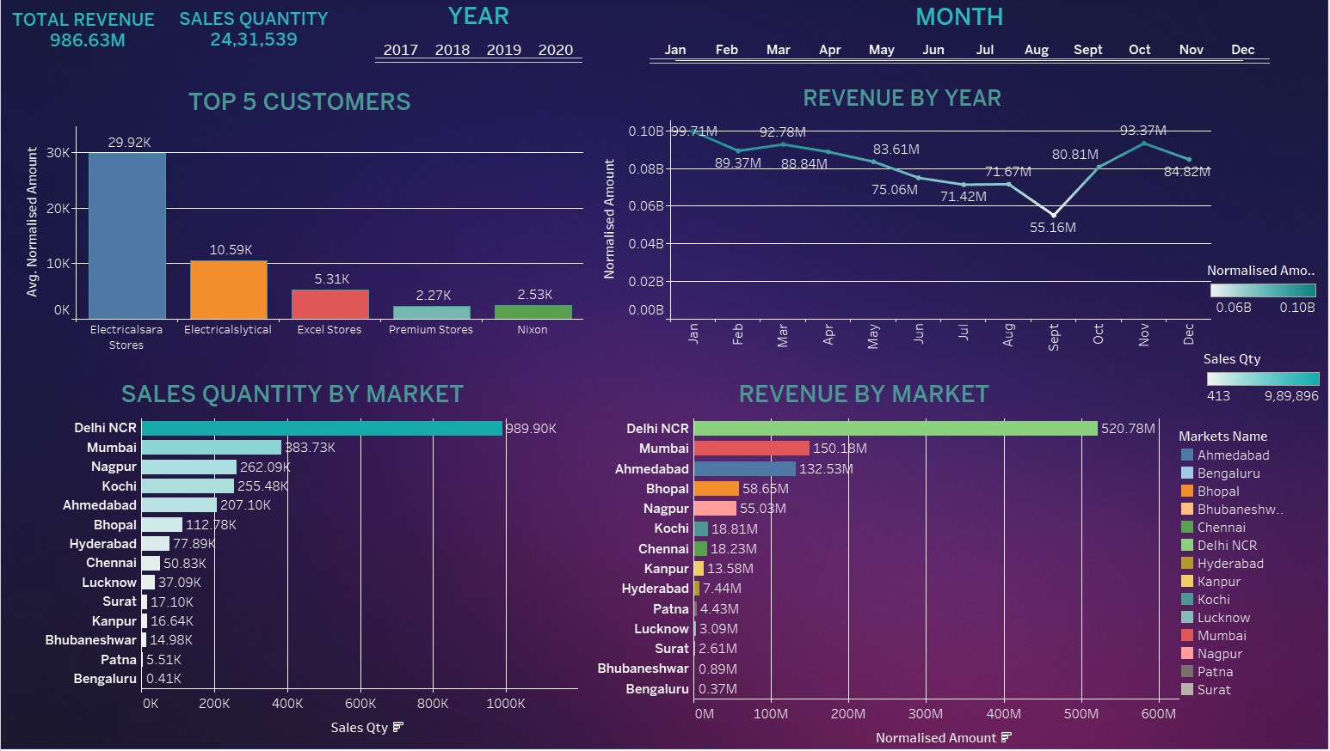

Slide 25


Slide 27
